Slide 1
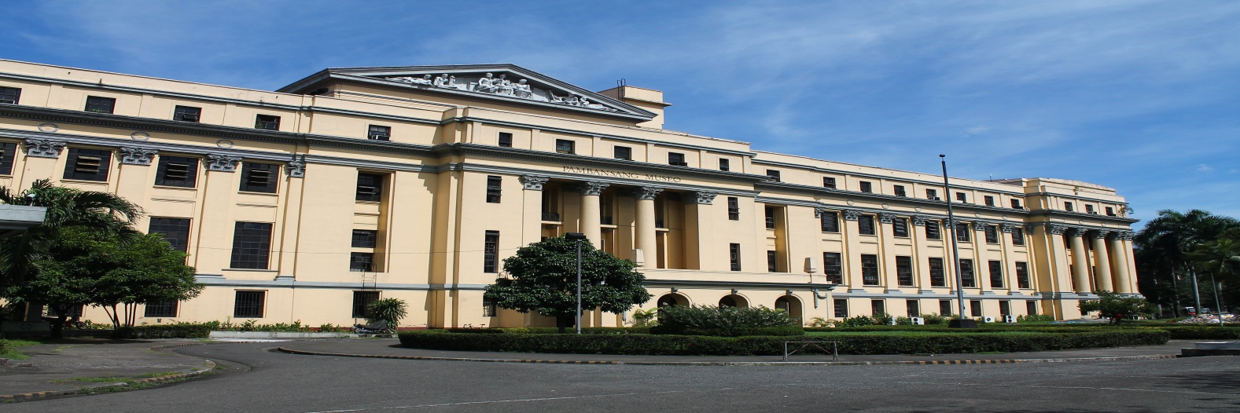
The National Museum of the Philippines
Manila, Philippines
Computer Art
By: Brandon Garcia

Slide 2
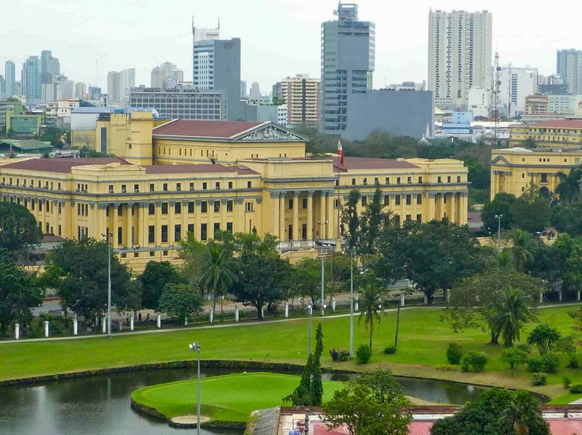
The museum was established in 1901 as an ethnography and natural history museum, and it was housed in its present building which was designed in 1918 by the American Architect, Daniel Burnham. The National Museum has since then broadened its concerns in the arts and sciences. Today, it occupies the main building (former Old Congress Building) where the arts, natural sciences and other support divisions are housed and the adjacent former Finance building in the Agrifina Circle of Rizal Park now called The National Museum of the Filipino People where the Anthropology and Archaeology Divisions are housed.

Slide 3
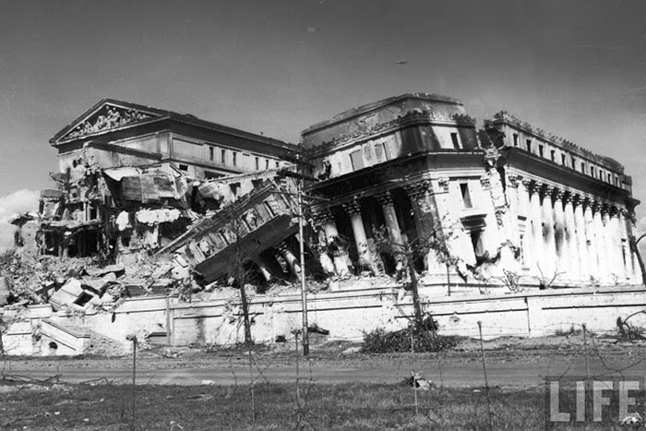
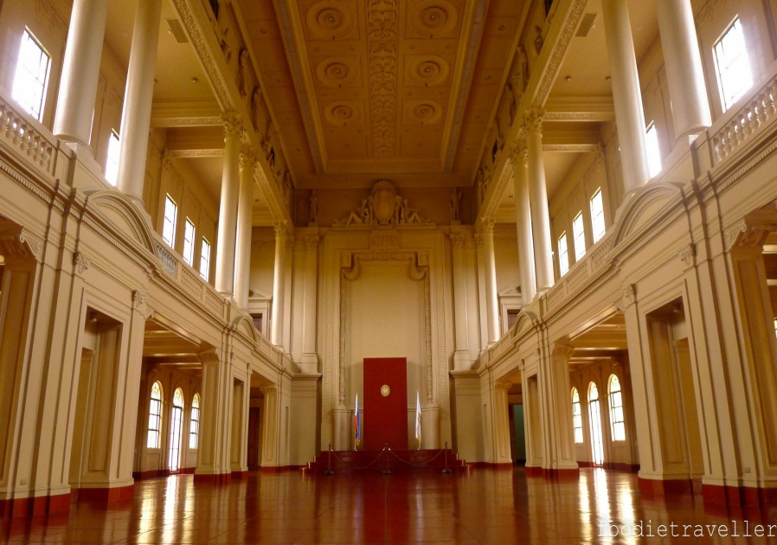
The museum was once the Old Legislative Building but it was destroyed
during the battles of WW2. Later, the building would be renovated and turned into the museum that it is today.

Slide 4
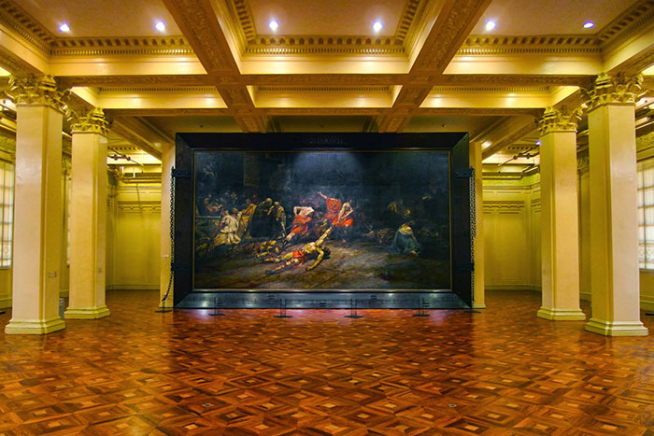
The museum is mostly known for the Spoliarium room. From there, you can actually see it up close. It is the largest painting in the Philippines. The Spoliarium was made by Juan Luna in Rome in the year 1884 as an entry to the Exposicion de Bellas Artes. It shows a scene from the Roman Colosseum’s exit room called “Spoliarium.” The Spoliarium is where the injured or dead gladiators are taken after performing.

Slide 5
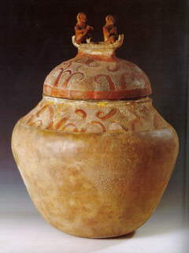
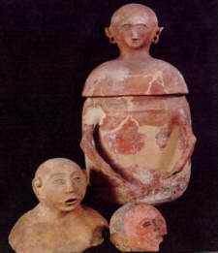
The Manunggul Jar was recovered at a chamber of Manunggul Cave in Palawan. It is designed burial jar with anthropomorphic figures on top of the cover that represent souls sailing to the afterworld in a death boat.
The anthropomorphic secondary burial jars from Pinol, Maitum, Saranggani Province in Mindanao back to the Metal Age.
The archeology in the Philippines conducts researches on the human past through material remains, artifacts, and ancient structures, with the aim of ordering and describing the events and knowing the purpose of these artifacts.

Slide 6
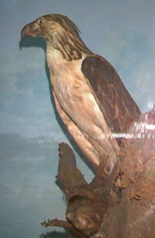
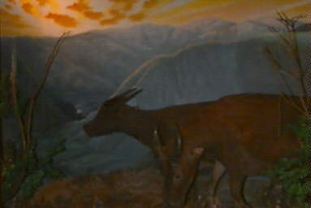
Tamaraw (Bubalus mindorensis)
The Philippine Great Eagle (Pithecophaga jefferyi)
Zoology conducts scientific researches on Philippine fauna; collects, preserves, identifies and exhibits to the public systematically all types of animals found in the Philippines.

Slide 7
Reflection
Learning about the ways in the Philippines is pretty interesting. I have only been to the Philippines a couple of times and I barely get to see the true inside of the Philippines, what it actually looks like. Learning about the Philippines and it’s history was a pretty cool experience for me because I can finally learn more about my heritage and culture. I happen to love History and learning about the history of the Philippines was a huge experience, getting to know what made everything that is today.

